Slide 1
VEHICLE AUTHORIZATION SYSTEM USING QR CODE
MEMBERS
Logesh , 3rd yr IT
Manojkumar, 3rd yr IT
Ganesh Karthik,3rd yr IT
AEP PROGRAM
Department of Information Technology
Meenakshi Sundararajan Engineering College

Slide 2
ABSTRACT
This work deals with the creation of a real-life android application, where all the necessary details of a vehicle are coordinated and stored by the user without much effort. Quick Response Code (QR-Code), a highly effective and fast readable technology is used for scanning various details of a vehicle.
The inspecting authority needs to scan a unique QR-Code (which is provided separately for every vehicle) into the mobile application. The simple UI provided in the application allows the faster recognition of the availability, or the lack of availability, of the important documents pertaining to that particular vehicle
In view of the security risks of exposing personal details of users, greater care has also been given for securing the data by using QR-Codes and securing access to those details.

Slide 3
OBJECTIVES
Restriction of unauthorised vehicle entry
Restricted time period entry for guests and participants
Report of entry and exit of vehicles

Slide 4
QR CODE ARCHITECTURE
DATABASE
MySQL
QR CODE
FRONT END
BACK END
HTML
JAVASCRIPT
PHP

Slide 5
PROJECT ARCHITECTURE
DATABASE
MySQL
ANDROID APPLICATION
FRONT END
BACK END
XML
JAVA CORE
PHP

Slide 6
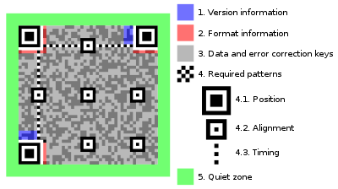
QR CODE COMPONENTS

Slide 7
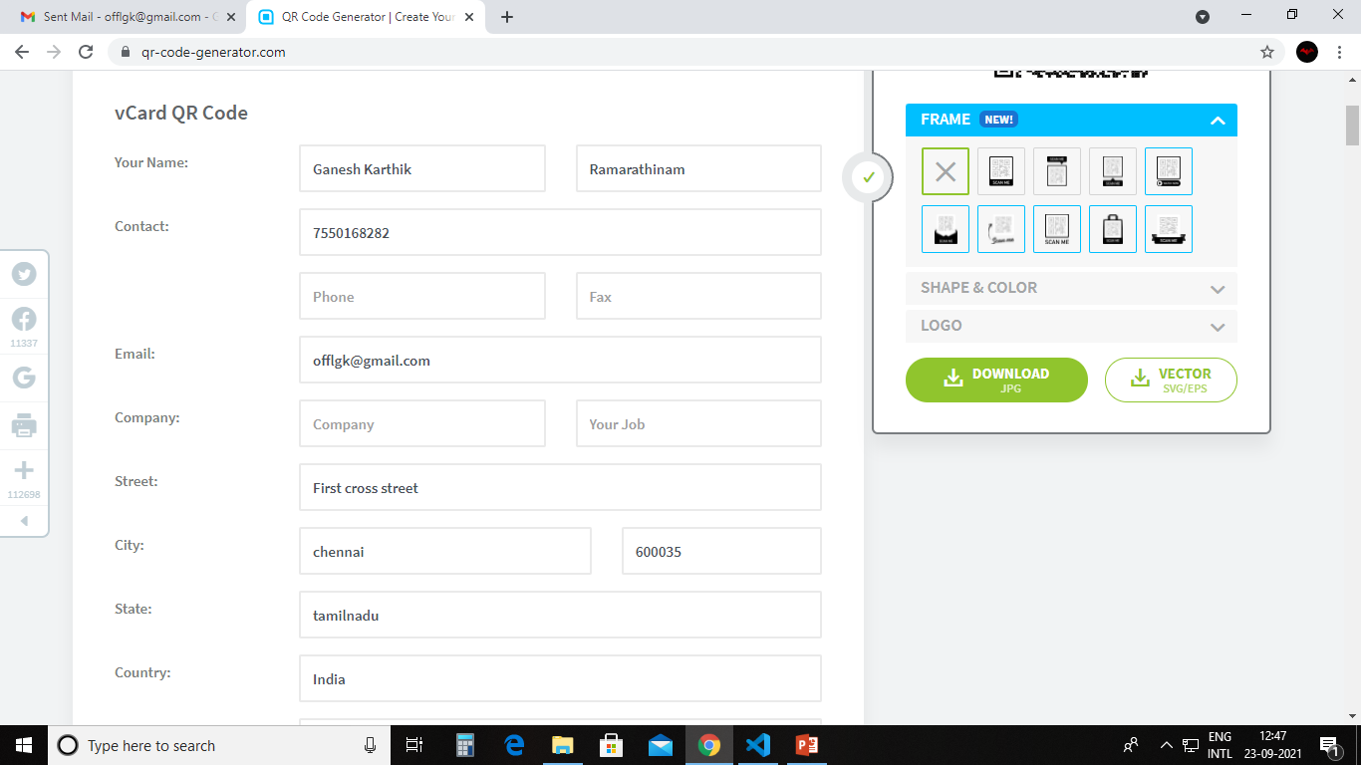
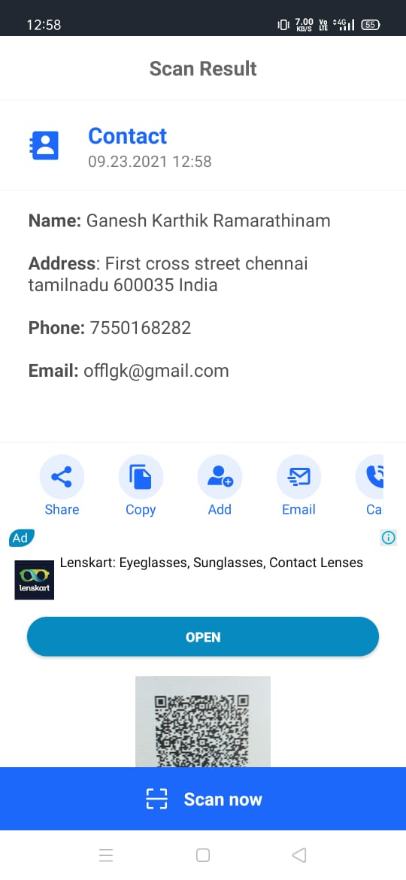

Slide 8
CONCLUSION
We thus, sincerely hope that this project would be a great resource to both the institutions and the Society. Being able to help the Society achieve this in a small way brings immense pleasure to us! We thank you for trusting us and providing us with this opportunity.

Slide 9

THANK YOU

